Slide 1
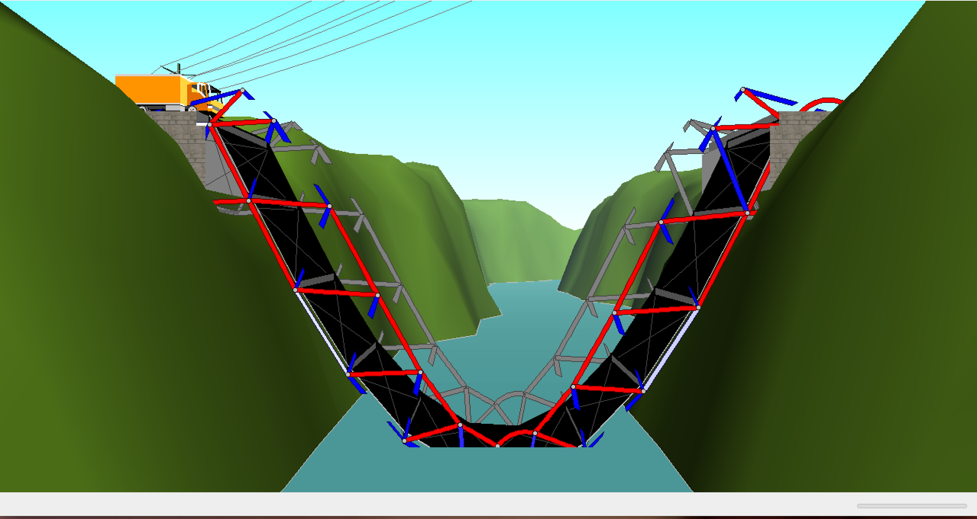
Statics Truss Project
BY: KELSEY CAMERON
MEGAN WHITE

Slide 2
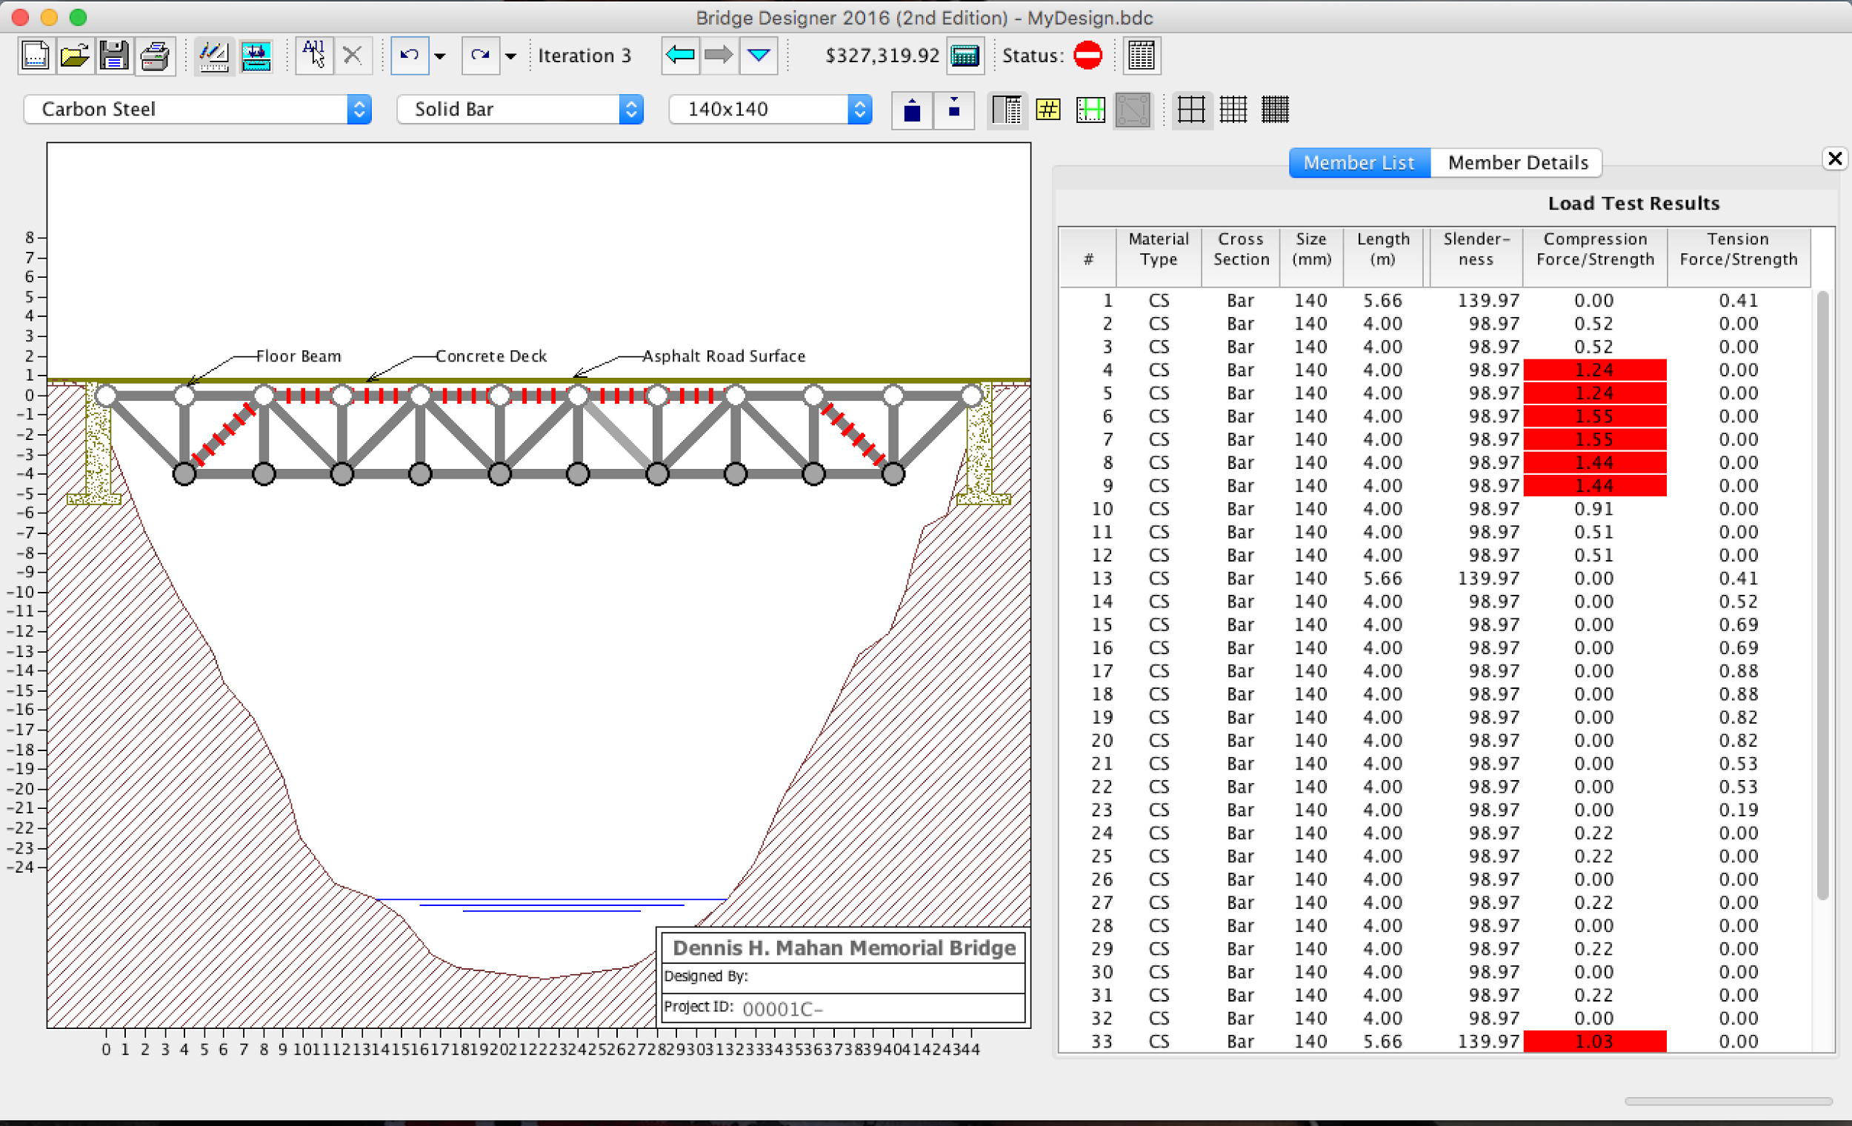
Our very First Design: Note, it was not our first WORKING design
Our idea of equilateral triangles
was a great one, however this
bridge had a few failures.
For one thing, the middle of the
bridge encountered too much
stress, from sheer force so the
bridge collapsed.
Our bridge was also a whopping 327k$.
We used what we learned from this
first design to gain a better approach
to the next design.

Slide 3
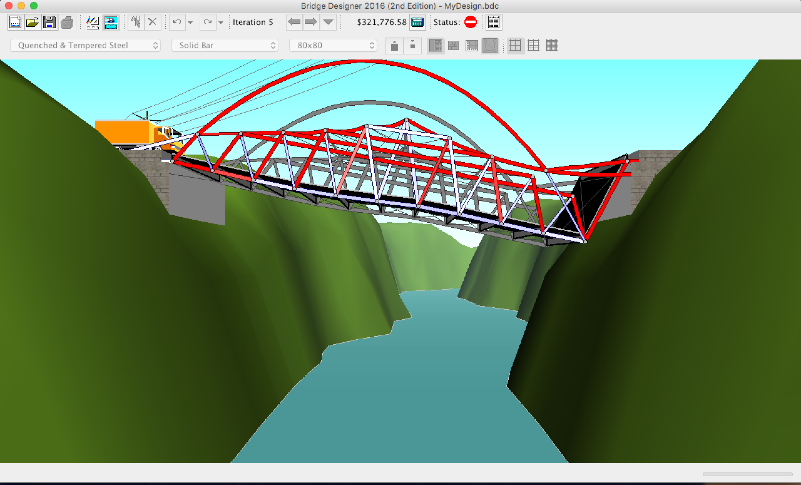
Different Tries from Kelsey – many failures…. The truck driver hates me.

Slide 4
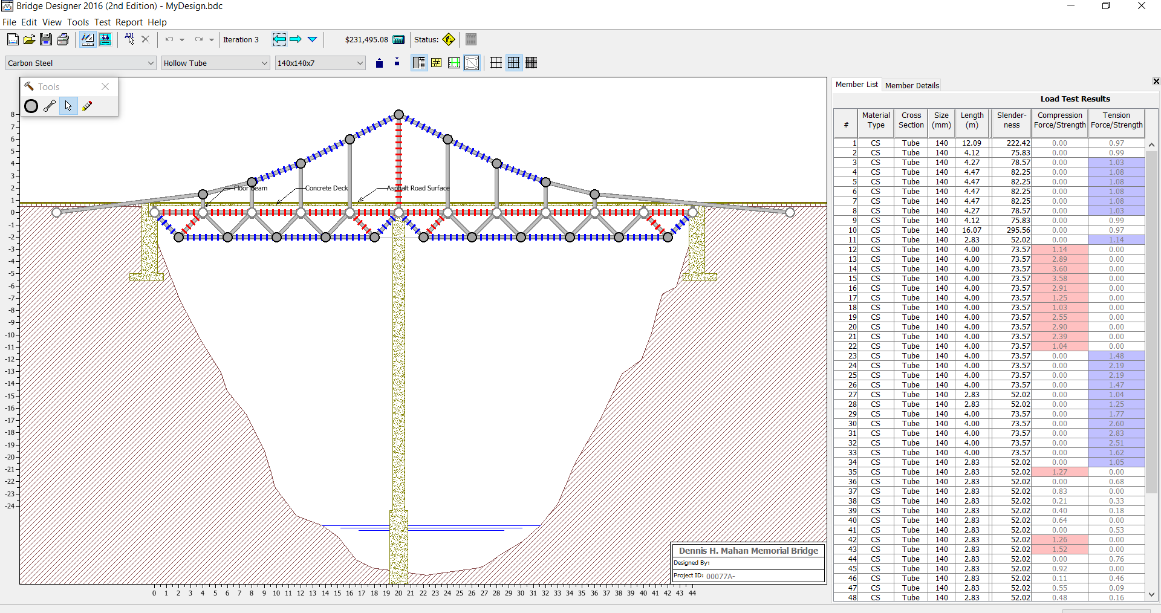
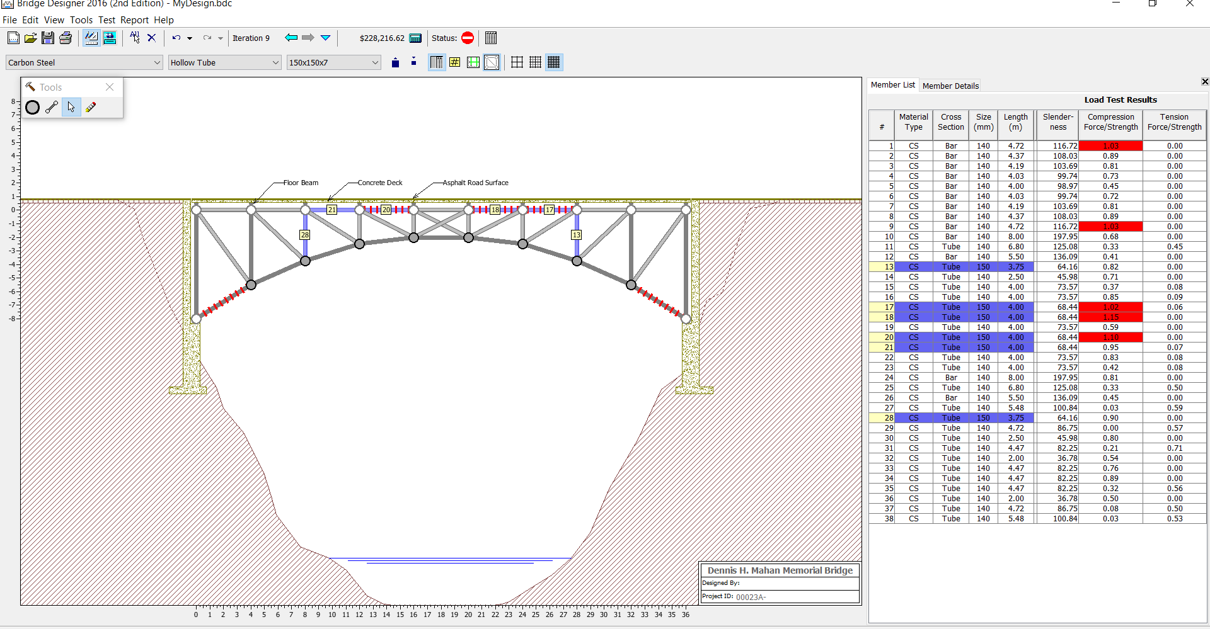
Different Tries from Megan – better designs, still didn’t work

Slide 5
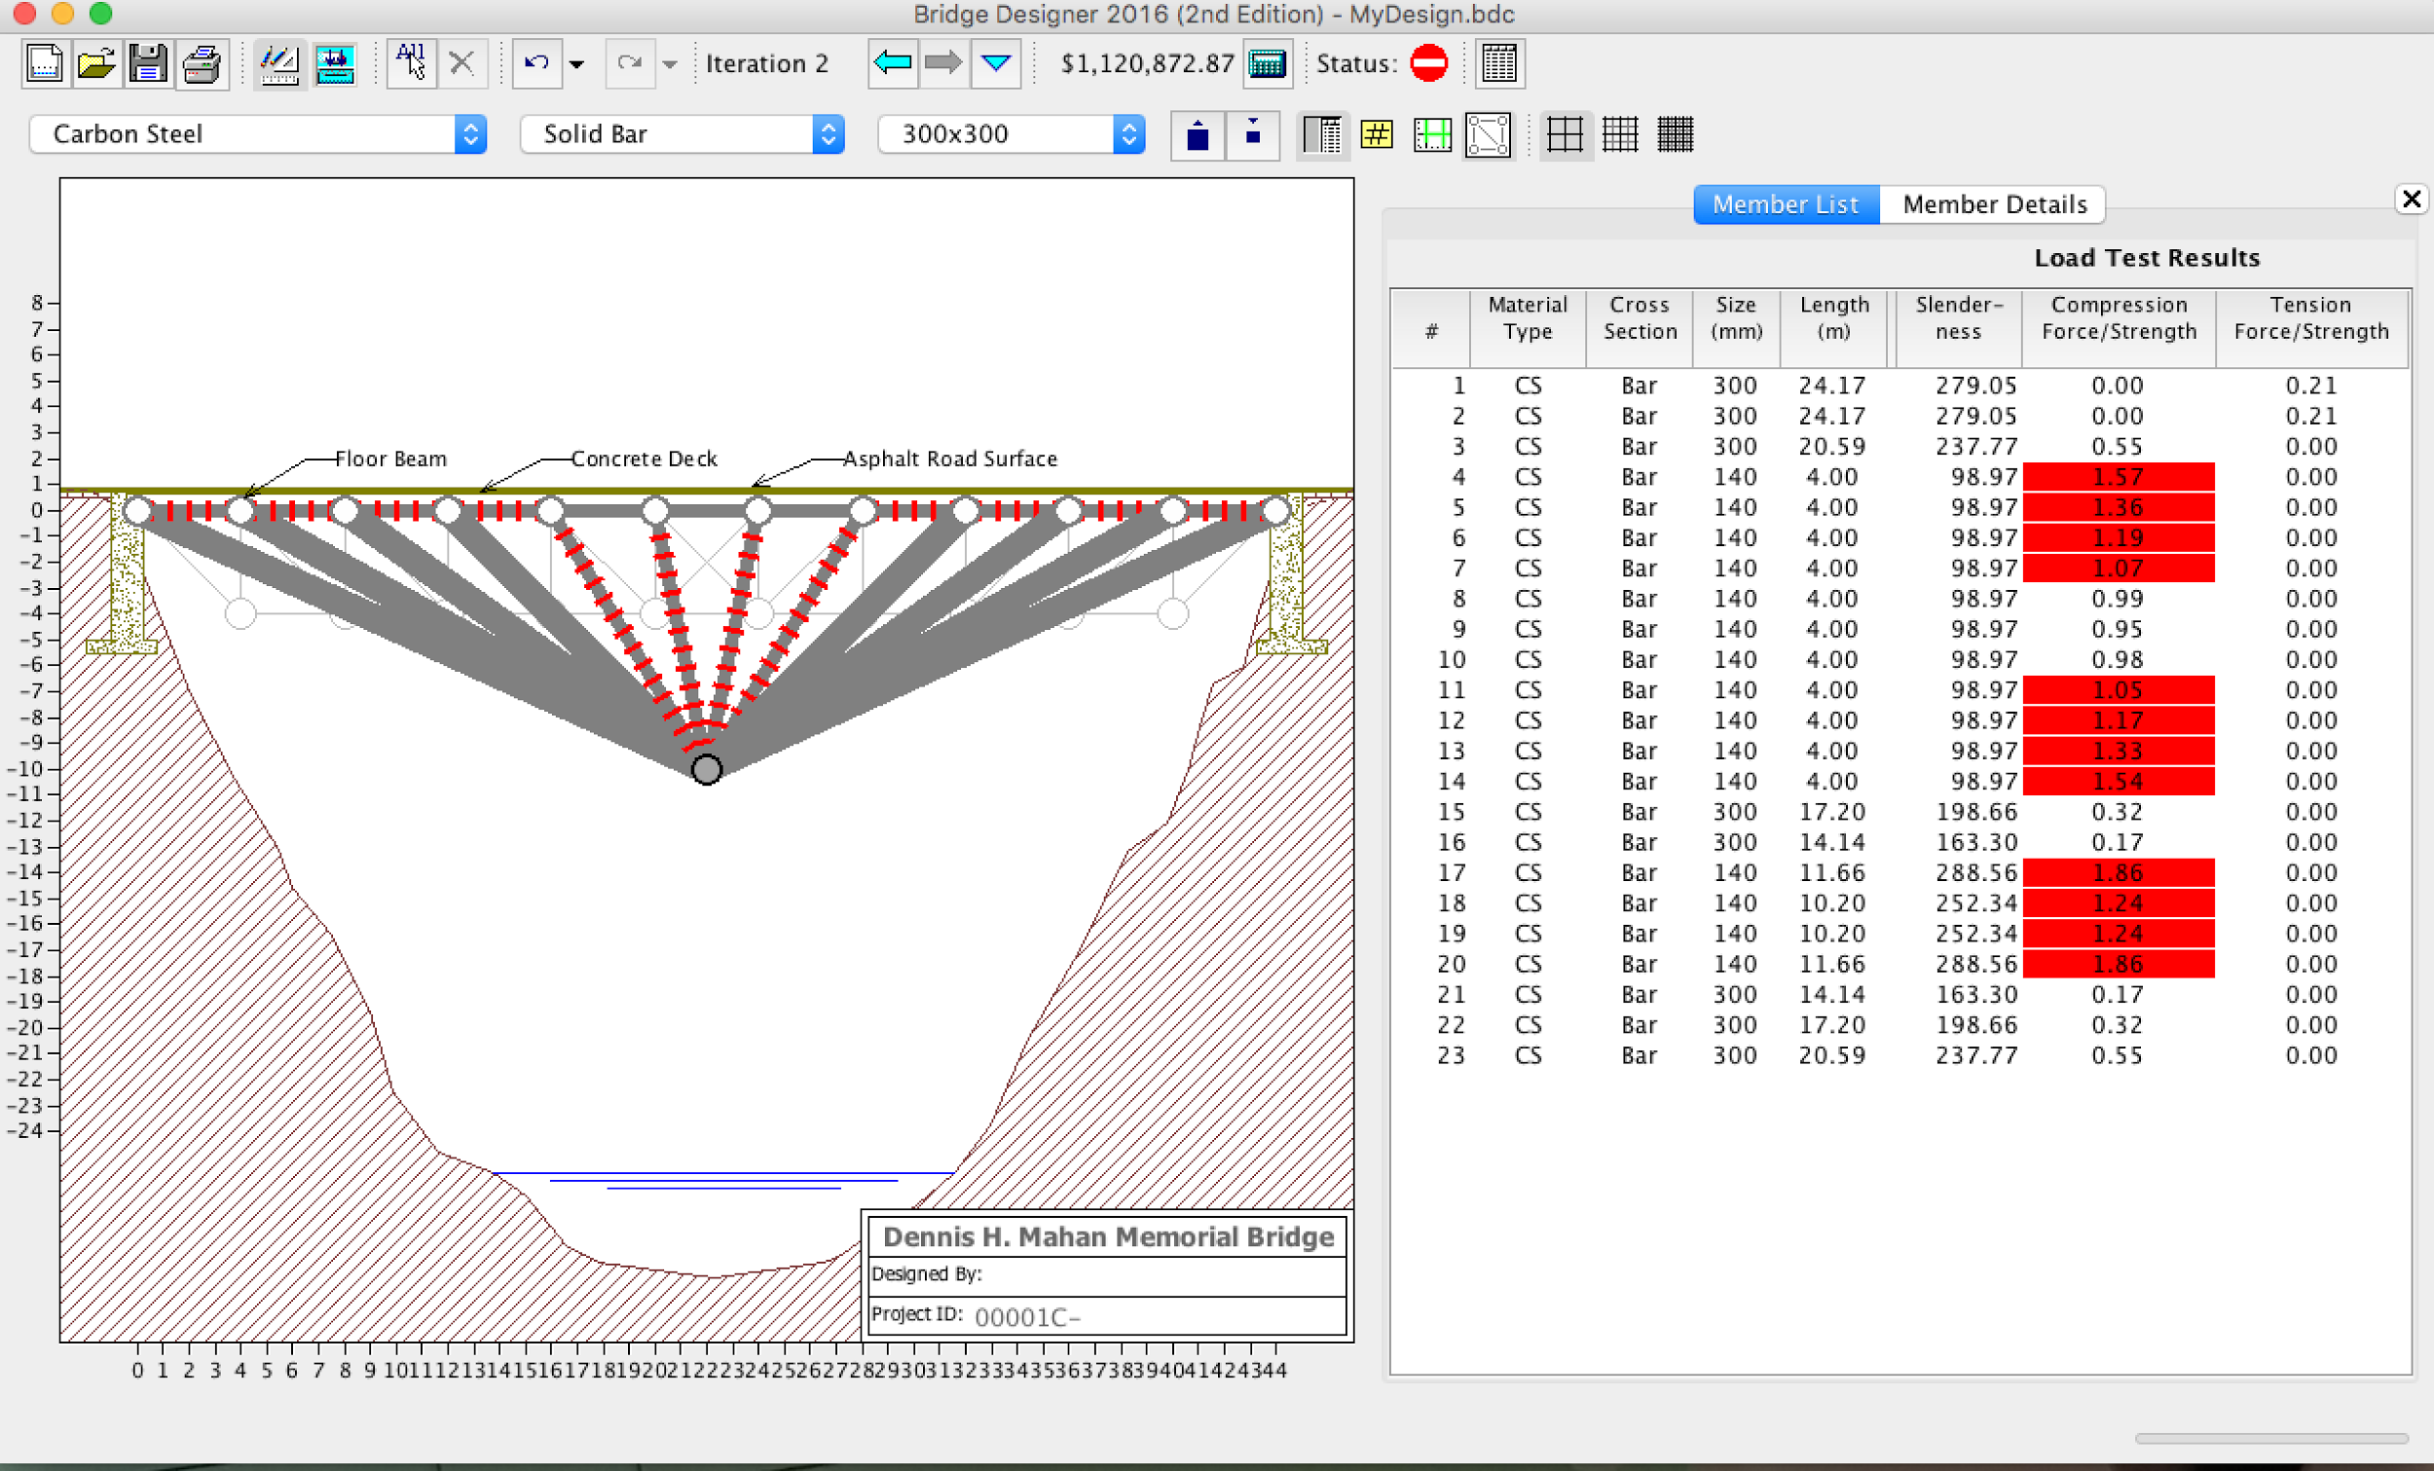
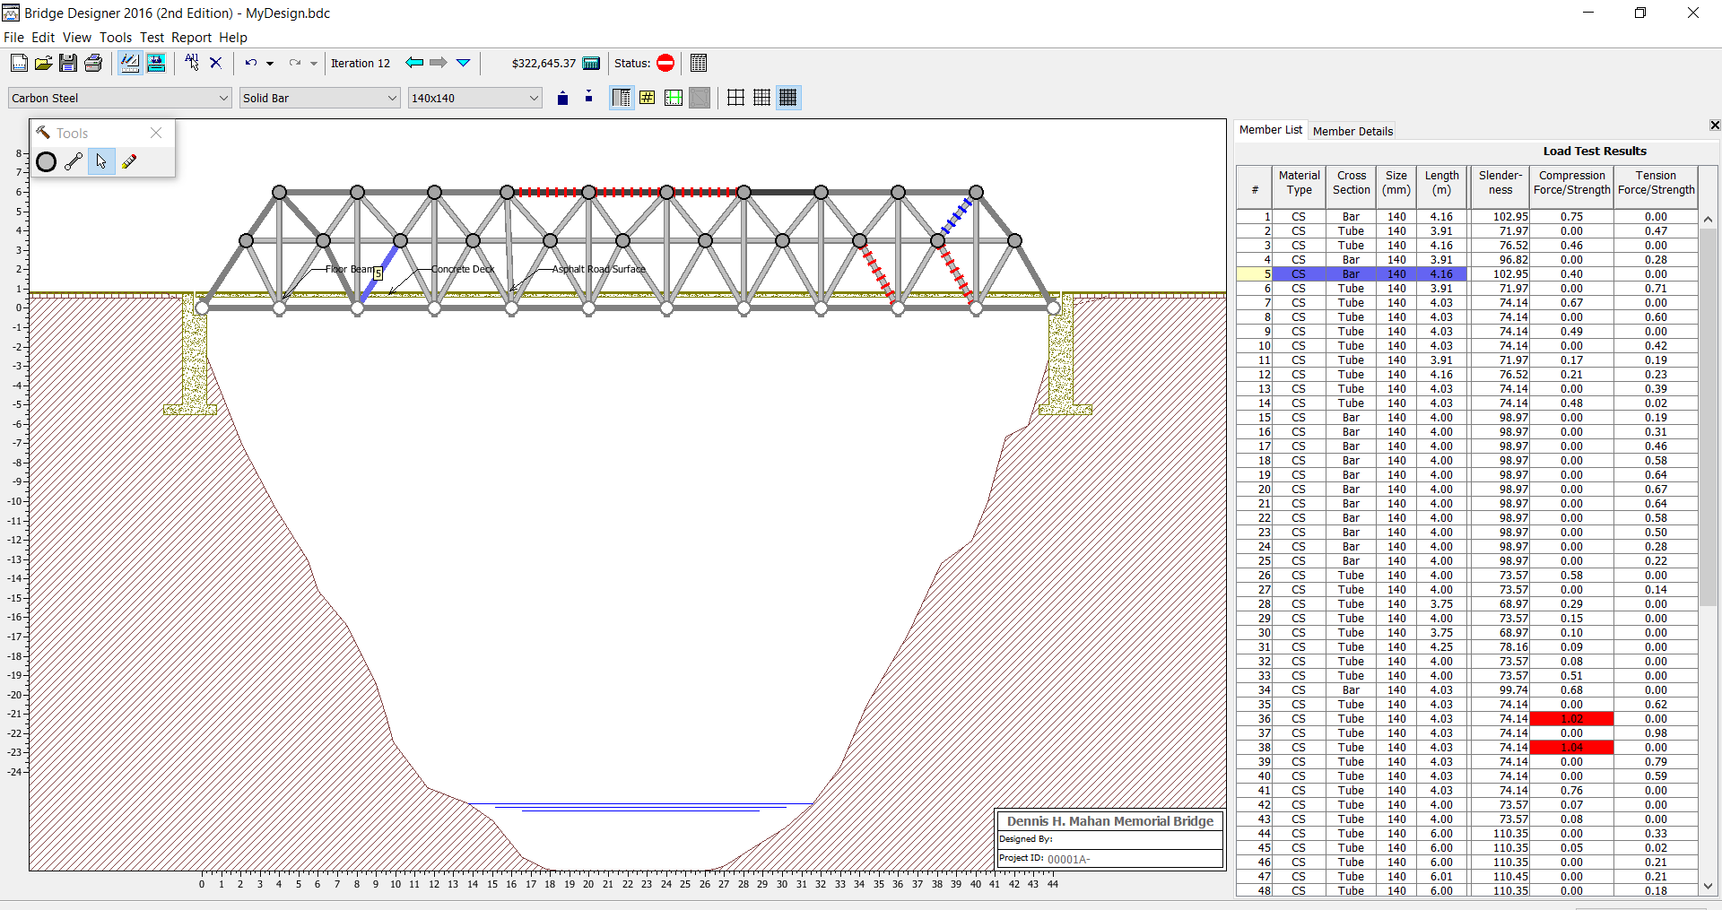
Other Unique…? Designs

Slide 6
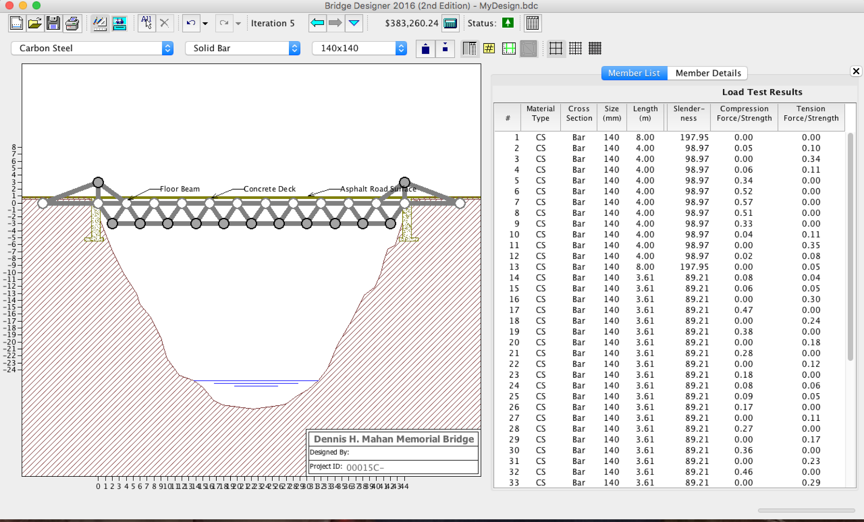
Our first working Design!
Eventually, we came across our first working design via team work and bouncing ideas back and forth.
This design kept the basic idea of equilateral triangles but simply added higher support beams and cable extensions.
However, this design was very costly at $383k.

Slide 7
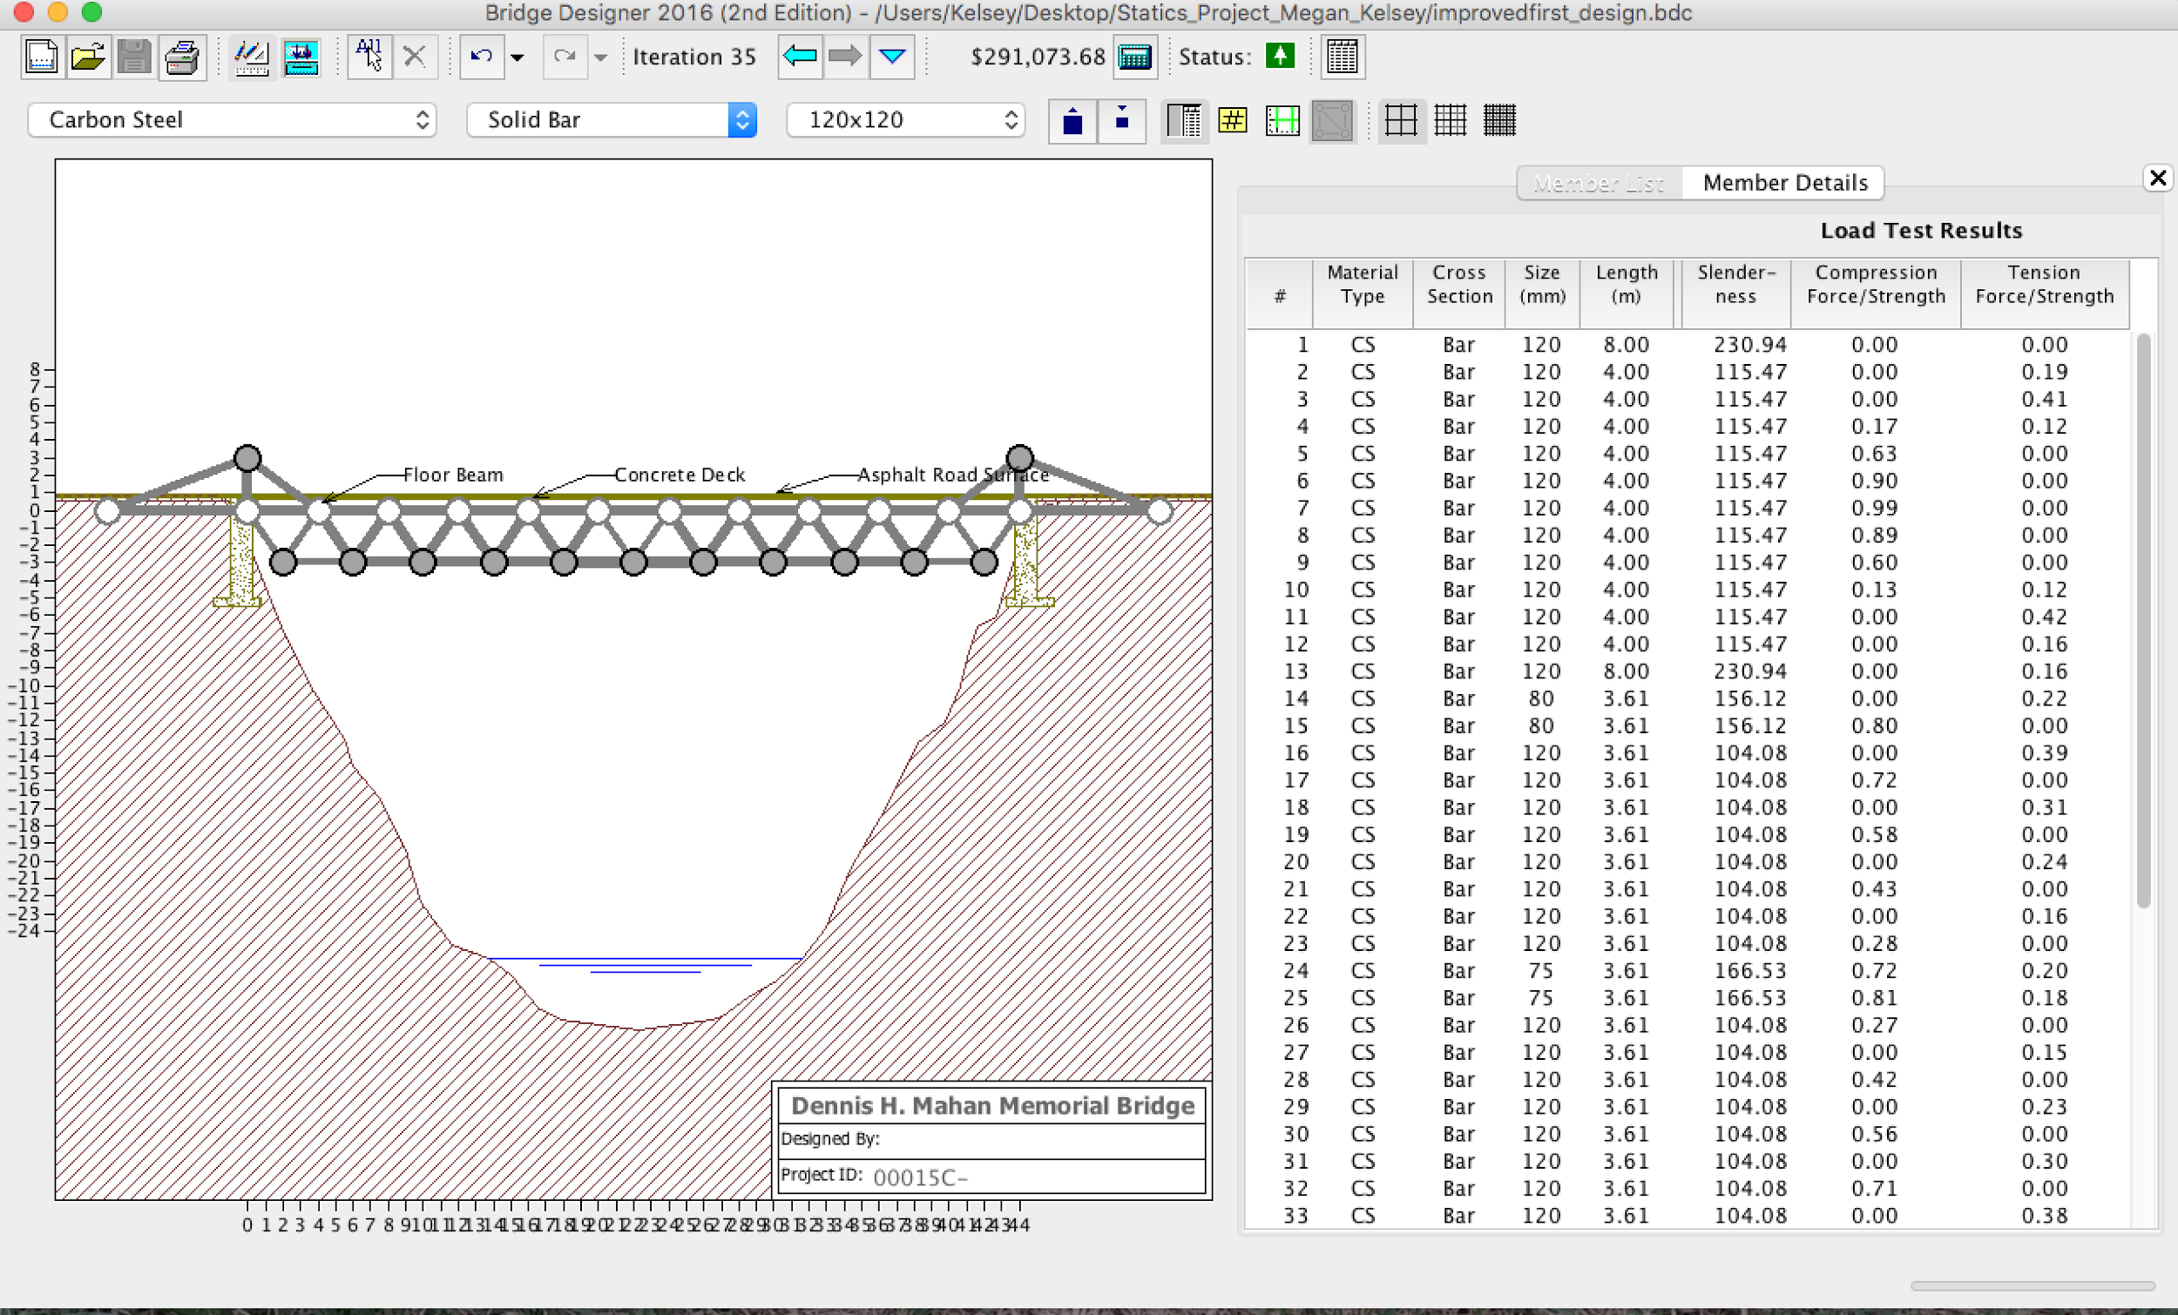
Improvements on First Design
We managed to improve our design by decreasing thicknesses and changing a few materials.
For the longest time, we believed this would be our final design, until we tested out how building a pier would affect our Truss…

Slide 8
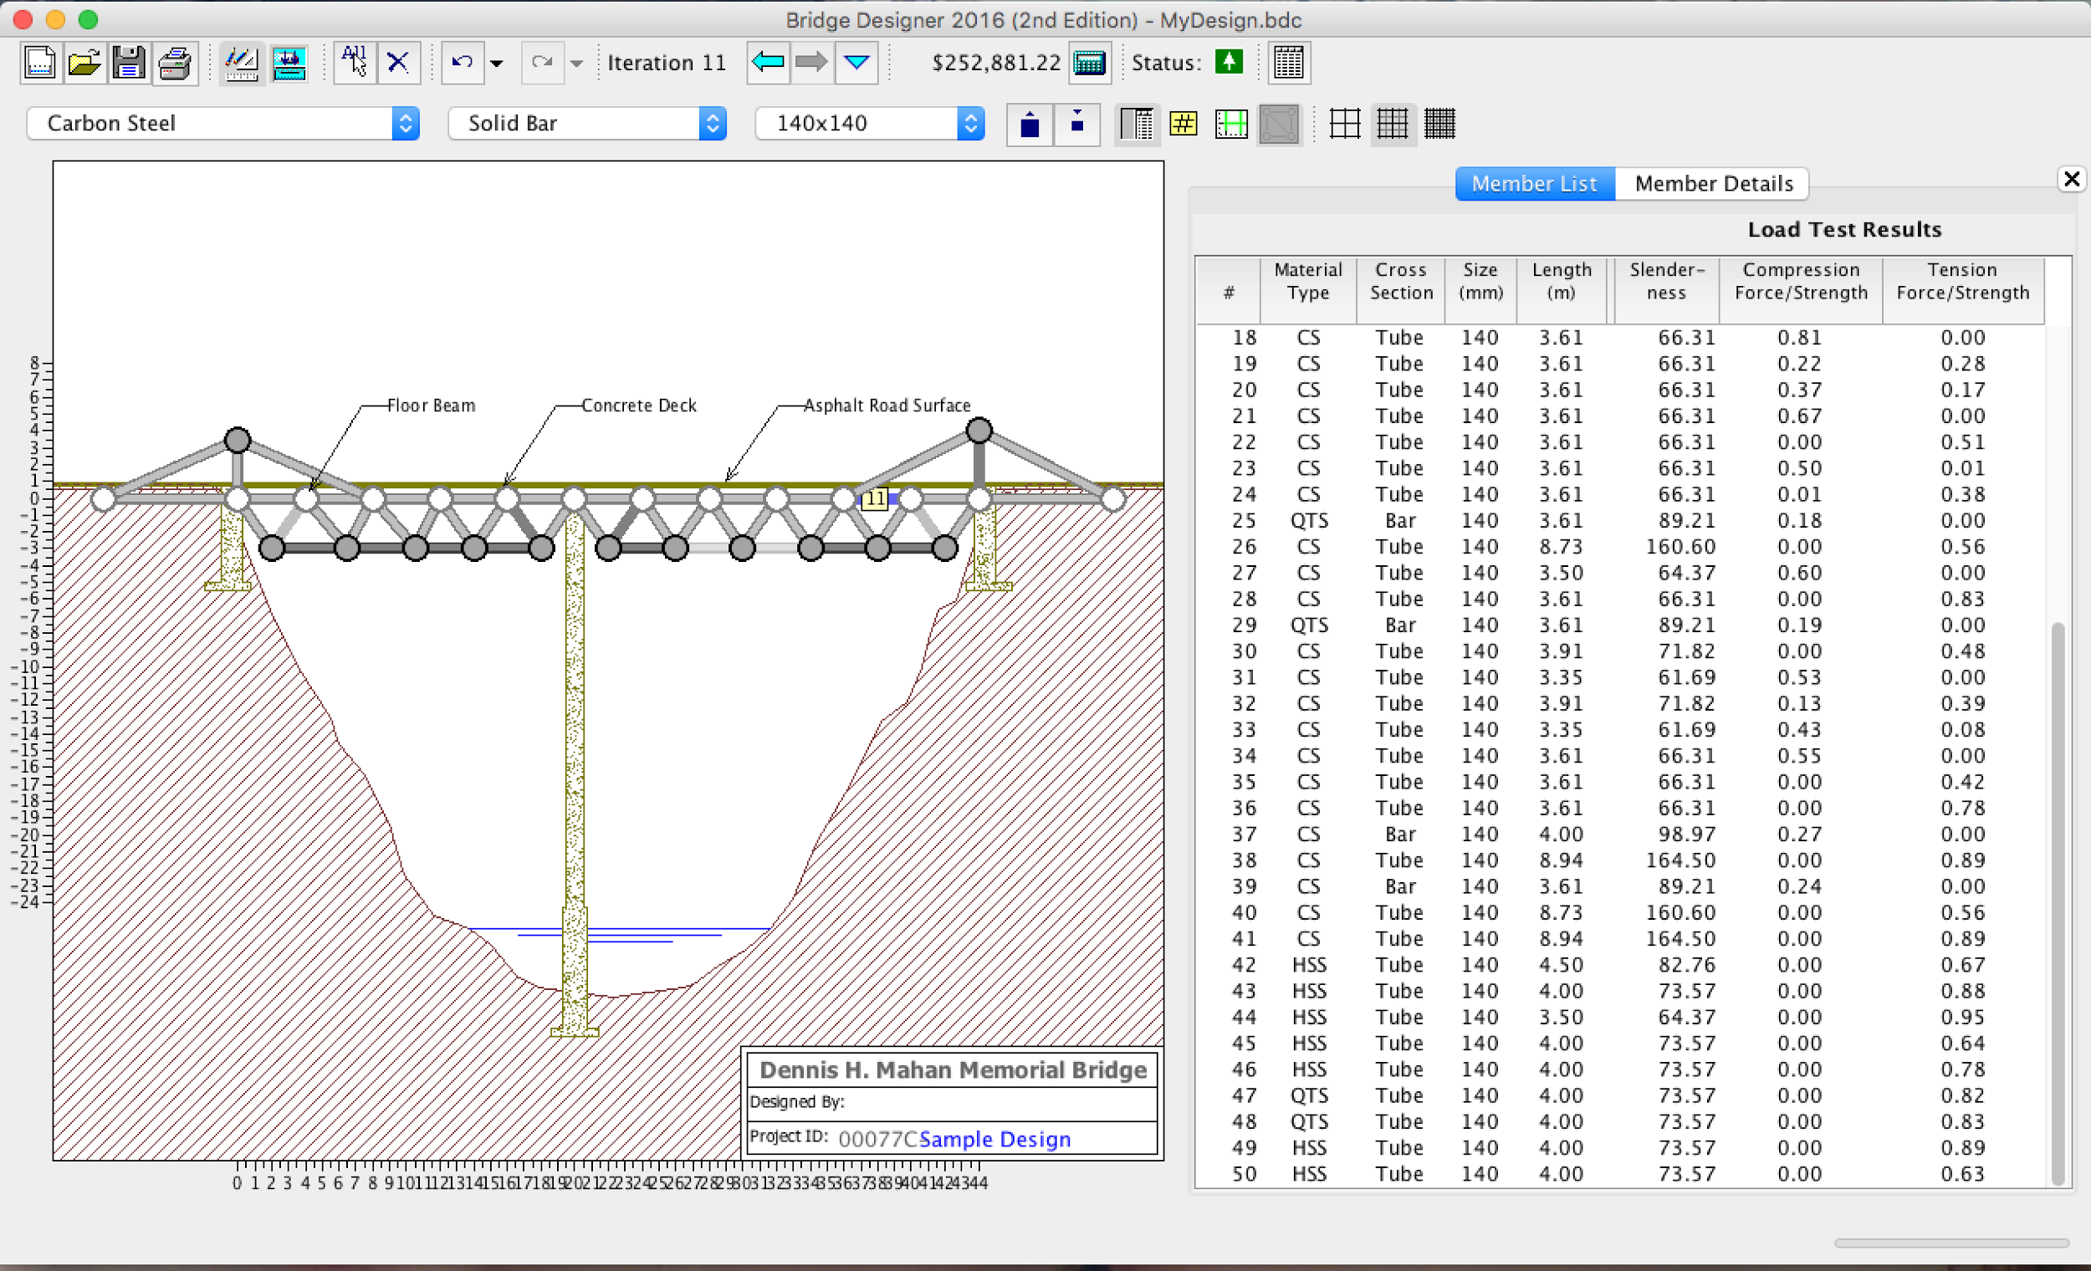
Our cheapest, and final Design!
Through incredible amounts of trial and error, we managed to change enough materials, to make the majority of our bridge out of hollow carbon tubing.
We maximized the strength of the critical members and managed to use the support of the pier to minimize stress and strain!

